Slide 1
Azure Windows Virtual Desktop
Design Document
v0.1
By Jack Rudlin 22/07/19

Slide 2
Windows Virtual Desktop (WVD) What is it?
Windows Virtual Desktop (WVD) is a cloud service hosted by Microsoft in Azure which offers applications via a Remote Desktop Services (similar to Citrix XenApp) type technology.
WVD is the only service to offer multi-user Windows 10 desktops running in the Azure cloud.
WVD is a cloud service and therefore accessible via the public internet.
Usage of the service is included as part of the M365 Office 365 licensing suite – the only costs are Azure computer resources.

Slide 3
WVD – Why do we need it?
WVD is a cost-effective, scalable cloud hosted application delivery mechanism for complex business applications which allows us to shift from a legacy Citrix XenApp infrastructure to a modern cloud hosted service.
Provides a secure, reliable and performant infrastructure hosted in close proximity to existing backend servers/services – low latency.
Isolates out-of-date, unsupported software in a centralized “locked-down” environment.
Avoids continuous Win10 “Evergreen” testing cycles.
Forms part of the Business Continuity Plan.
Removes need for VPN’s.
In the future, as the service is internet/web based, we will be able to offer it to users working on any device, personal or corporate!

Slide 4
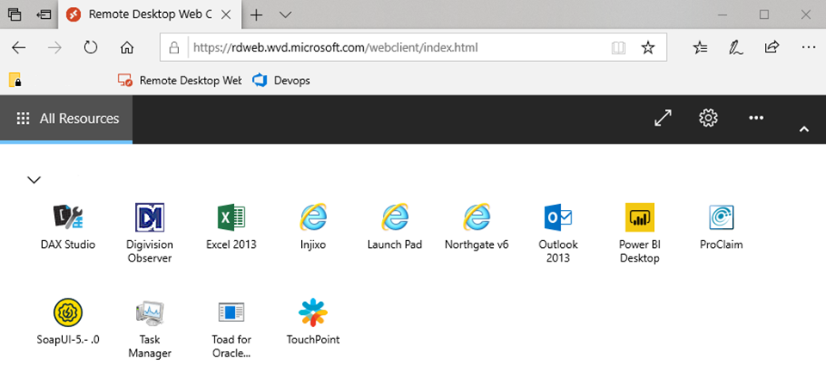
WVD – What does it look like? HTML5 Browser Based

Slide 5
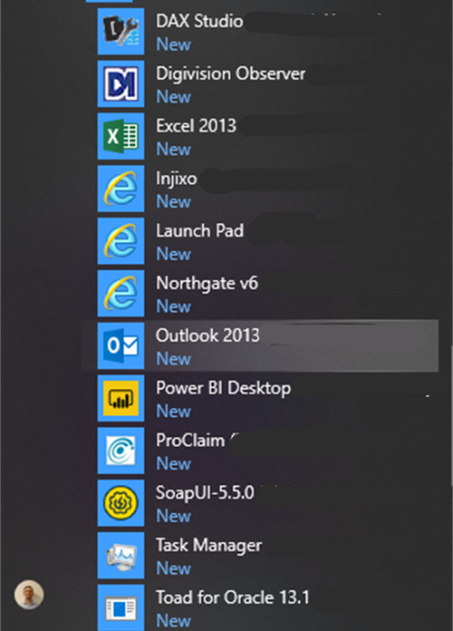
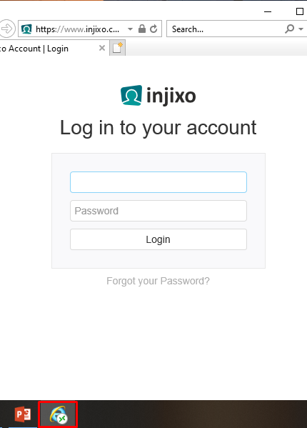
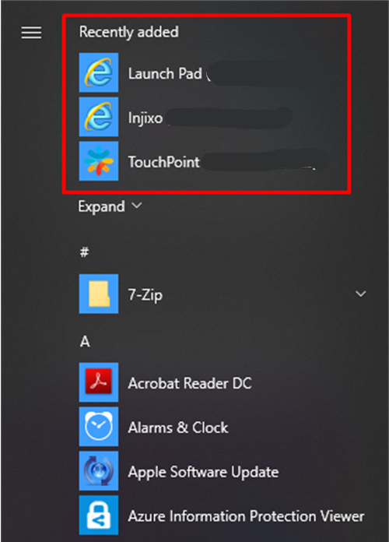
WVD – What does it look like? Windows 10 via Start Menu

Slide 6
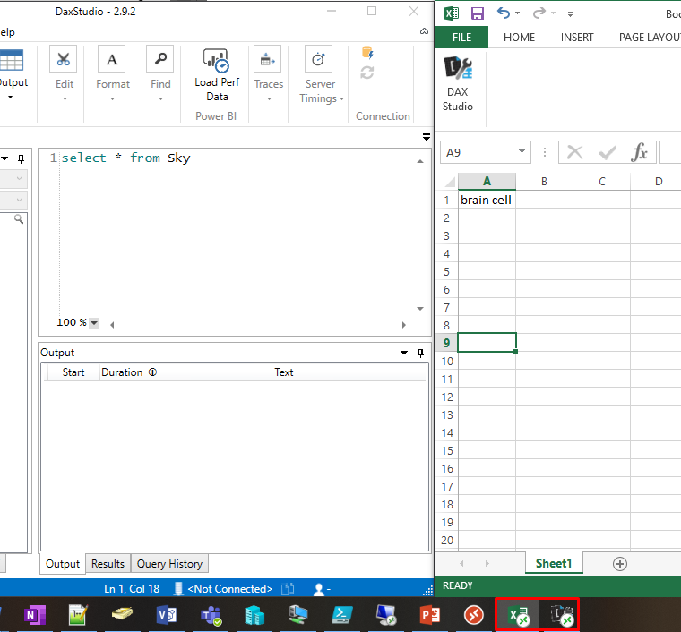
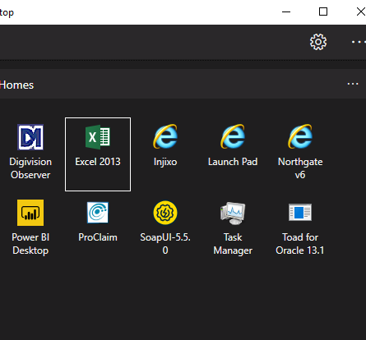
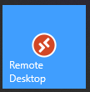
WVD – What does it look like? Windows 10 via Remote Desktop Client

Slide 7
WVD – Infrastructure Design Overview

Slide 8
WVD – Infrastructure Components

Slide 9
WVD – VM Image Components

Slide 10
WVD – Application Release Flow

Slide 11
WVD – Devops CI/CD Lifecycle

Slide 12
WVD – Cost criteria
The costs associated with WVD come mostly from Azure Virtual Machines running Windows 10, so compute and storage.
Roaming user profiles are stored on blob storage.
Outbound ExpressRoute data costs.
Cost criteria:
100 concurrent users
600 users total
1 user per ~1Gb memory
1Gb profile size per user
Microsoft sizing guide

Slide 13
WVD – Costs
D8s_v3 = 8vCPU 32Gb £xx 12800iops / 388/user
B2s = 2vCPU 4Gb £xx x 8 = 16vCPU / 32Gb 12800iops / 388/user
B8ms = 8vCPU 32Gb £xx 4320iops / 130/user
B2ms = 2vCPU 8Gb £xx x 4 = 8vCPU / 32Gb 9600iops / 290/user
Note: Above costs are Per machine
Prices are per annum and based on a PayG model, where ¾ of machines are shutdown out of business hours.
Scenario | Light 33 users p/server | Medium 25 users p/server
Compute
OS Storage
Profile Storage (600GB)
Data transfer
Total

Slide 14
WVD – Current Limitations
Cannot assign applications by AD Group, only by direct user assignment.
The WVD service is still in public preview – it is due to go Generally Available (GA) in 2020H1.
The closest WVD broker is in the East Coast of USA – this will change to UK South when it goes GA, but currently is presents a small amount of latency.

